Slide 1

Academic Session 2025-26
ODD Semester Jul-Dec 2025
UNIVERSITY INSTITUTE OF ENGINEERING
COMPUTER SCIENCE & ENGINEERING
Bachelor of Engineering
CSE - 7th Sem.
Program code: CS201, CS202, IT201,IT201,BI159, CS703 & CS704
Cyber Crime Investigation and Cyber Forensic(22CSH-424)
Unit No.01 Chapter No.01 Lecture No.1.1.1
Topic : Introduction to Computer Crime - Definition, scope, and importance
Er. Munish Kumar E_Code:16513 Designation: Assistant Professor

Slide 2
1
Learning Objectives
Objectives-1: Clearly explain what computer crime is and differentiate between computers as targets and as instruments of crime.
Objectives-2: Outline the historical evolution of computer crime, identifying key periods, early incidents, and significant milestones or legislation.
Objectives-3: Categorize and provide examples of computer crimes affecting individuals, businesses/organizations, and governments/society.
Objectives-4: Briefly discuss factors influencing the ongoing expansion of computer crime's scope.

Slide 3
2
Topic to Covered
Topic 1. Introduction to Computer Crime
Topic 2. History of Computer Crime
Topic 3. Scope of Computer Crime

Slide 4
3
Introduction to Cyber Forensics
Computer crime, often interchangeably referred to as cybercrime, is a constantly evolving and significant challenge in our increasingly digitized world. Cybercrime refers to illegal activities involving computers, networks, or the internet as a tool to commit offenses. Common Types of Cybercrime:
Identity Theft: Stealing personal info for fraud.
Financial Fraud: Online scams, fake transactions.
Cyber bullying: Digital harassment or threats.
Phishing Attacks: Deceptive attempts to get sensitive data.
Hacking: Unauthorized system access and data breaches.
Malware Attacks: Spreading viruses, ransom ware, etc., to harm or steal.
BOOK: Cybersecurity and Cybercrime" by Nina Godbole and Sunit Belapure

Slide 5
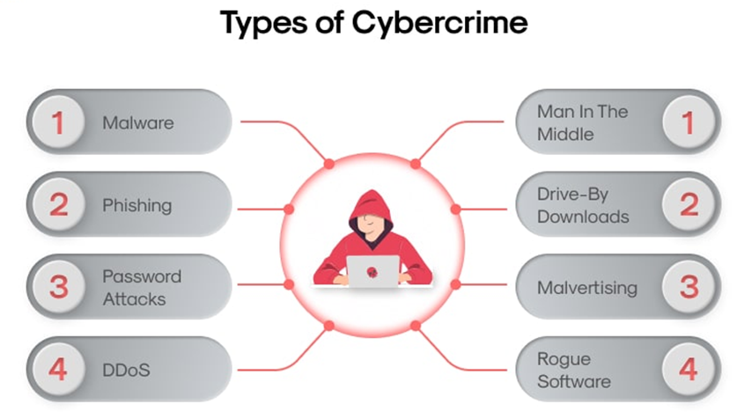
4

Slide 6
5
Examples of Cyber Crime
Financial Fraud:
Cybercriminals steal personal and financial data to commit fraud, open fake bank accounts, or make unauthorized transactions. Phishing attacks are one of the most common methods used to trick victims into providing sensitive information.
Example: A phishing email pretending to be from a bank, asking users to enter their login details on a fake website.

Slide 7
6
Examples of Cyber Crime
Cyber Extortion (Ransom ware Attackes):
Cyber extortion happens when hackers attack websites or computer systems and demand money to stop the attacks. They threaten to keep attacking unless they receive a large payment.
Example: A ransom ware attack on a hospital system, blocking access to patient records until a ransom is paid

Slide 8
7
Challenges of Cyber Crime
1. Lack of User Awareness
Many users, especially less tech-savvy individuals, are unaware of their cyber rights or how to protect themselves.
2. Anonymity of Perpetrators
Cybercriminals often operate anonymously, making identification and apprehension extremely difficult.
3. Underreporting of Cases
A low number of registered cases hinders accurate tracking and effective response, encouraging more crime.

Slide 9
8
Challenges of Cyber Crime
4. Sophisticated Offenders
Cybercrimes are frequently committed by highly skilled and technical individuals who know how to evade detection.
5. Insufficient Penalties
Lack of consistently harsh punishments (except for severe cases like cyber terrorism) can incentivize cybercriminals.

Slide 10
9
Impact of Cybercrimes
1. Financial Losses
Significant monetary losses for individuals and organizations due to fraud and theft.
2. Reputational Damage
Erosion of trust and public image, leading to lost customers and business.
3. Operational Disruption
Shutdown of systems and networks, resulting in lost productivity and service downtime.
4. Legal Consequences
Lawsuits, regulatory fines, and increased compliance costs for affected entities.

Slide 11
10
How to Protect Yourself Against Cybercrime?
1. Use Strong, Unique Passwords
Create complex passwords (letters, numbers, special characters) for each account.
Avoid writing them down.
2. Install & Maintain Antivirus
Use reputable and up-to-date antivirus software on all devices.
3. Enable Two-Factor Authentication (2FA)
Add an extra layer of security requiring a second verification step for accounts.

Slide 12
11
How to Protect Yourself Against Cybercrime?
4. Keep Software Updated
Regularly update your operating system and all software to patch vulnerabilities.
5. Use Secure Networks
Avoid sensitive transactions on public Wi-Fi; use secure, private networks.
6. Be Wary of Spam/Attachments
Never open suspicious email attachments or click links from unknown senders.

Slide 13
12
History of Computer Crime
1. Early Days (1960s-1970s)
Insider crimes on mainframes.
Data manipulation, unauthorized resource use.
"Hacking" emerged as exploration.
2. PC & Network Rise (1980s)
Proliferation of personal computers and early networks (ARPANET).
Emergence of computer viruses, phone phreaking, early network intrusions.
Kevin Mitnick gained public attention.
3. Internet Explosion (1990s)
Rapid global internet adoption.
Email scams, website defacement, sophisticated malware.
New e-commerce fraud opportunities.
Law enforcement began facing transnational challenges.

Slide 14
13
History of Computer Crime
4. 21st Century: Sophistication & Professionalization (2000s-Present)
Organized Cybercrime Rings: Business-like operations.
Ransomware Epidemic: Encrypting data for payment.
Advanced Persistent Threats (APTs): State-sponsored or large-group attacks.
Dark Web: Anonymous marketplaces for illicit goods.
IoT Vulnerabilities: New attack vectors from connected devices.
Cryptocurrency Crime: Theft and money laundering.
Massive Data Breaches: Affecting millions, costing billions.
Critical Infrastructure Focus: Threats to essential systems.

Slide 15
14
Scope of Computer Crime
1. Individuals
Victims face financial losses, identity theft, reputational damage, and emotional distress from cyberstalking/harassment.
2. Businesses & Organizations
Suffer financial losses (theft, IP), reputational damage, operational disruption, and legal liabilities.
Finance, healthcare, and retail are common targets.
3. Governments & National Security
Threats include espionage, critical infrastructure sabotage, and interference in political processes.
Rising concerns about cyberwarfare and cyberterrorism.

Slide 16
15
Scope of Computer Crime
4. Global Reach
Borderless internet makes investigation and prosecution challenging due to perpetrators' anonymity and international locations.
Requires international cooperation.
5. Economic Impact
Trillions of dollars lost annually worldwide, including direct losses, recovery costs, and lost productivity.
6. Technological Evolution
Methods and targets evolve with new tech (AI, quantum computing, 5G), demanding constant adaptation of security and laws.
7. Social & Ethical Dimensions
Raises questions about privacy, surveillance, freedom of speech, and responsible tech use.

Slide 17
16
Quiz/ FAQ’s
1. Define & Differentiate
What is computer crime?
Two ways computers are involved (target vs. instrument) + examples.
2. Trace Historical Evolution
Key developments from early forms to modern cybercrime.
How technology/society fueled its growth.
3. Understand Broad Scope & Impact
How cybercrime affects individuals, businesses, and governments.
Examples for each category.
4. Recognize Milestones & Incidents
At least three significant historical cybercrime events or laws.
5. Anticipate Future Trends & Challenges
Emerging tech/trends impacting future cybercrime.

Slide 18
17
References/ Articles/ Videos
Books
1.Cybercrime: Law and Practice This book provides a comprehensive overview of cybercrime laws and practices, including definitions, historical context, and the scope of cybercrimes.
2. Computer Crime: A Crimefighter's Handbook This handbook offers insights into the evolution of computer crimes, legal frameworks, and practical approaches to combating cybercrime.

Slide 19
18
References/ Articles/ Videos
YouTube Video Links
What is Cybercrime? | Introduction to Cybercrime https://www.youtube.com/watch?v=QvOa0Eo5htw
History of Cybercrime | Cybercrime Explained https://www.youtube.com/watch?v=j6MPuhyJoPM
🎓 NPTEL Video Links
Introduction to Information Security I (Lecture 1: Introduction to Cyber Security) https://nptel.ac.in/courses/106/106/106106129/video/Lecture-01.mp4
Ethical Hacking (Lecture 2: Introduction to Ethical Hacking and Cyber Crime) https://nptel.ac.in/courses/106/105/106105217/video/Lecture-02.mp4
💼 LinkedIn Learning Video Links
Learning Cybersecurity Foundations https://www.linkedin.com/learning/learning-cybersecurity-foundations
Cybersecurity Awareness: Security for IT Professionals https://www.linkedin.com/learning/cybersecurity-awareness-security-for-it-professionals

Slide 20
19
Thank You
For Queries
Email: munish.e165713@cumail.in

